Slide 1
Thread

Slide 2
Motivation
Most modern applications are multithreaded
Threads run within application
Multiple tasks with the application can be implemented by
separate threads
Process creation is heavy-weight while thread creation is light-
weight
Can simplify code, increase efficiency
Kernels are generally multithreaded

Slide 3









Multithreaded Server Architecture

Slide 4
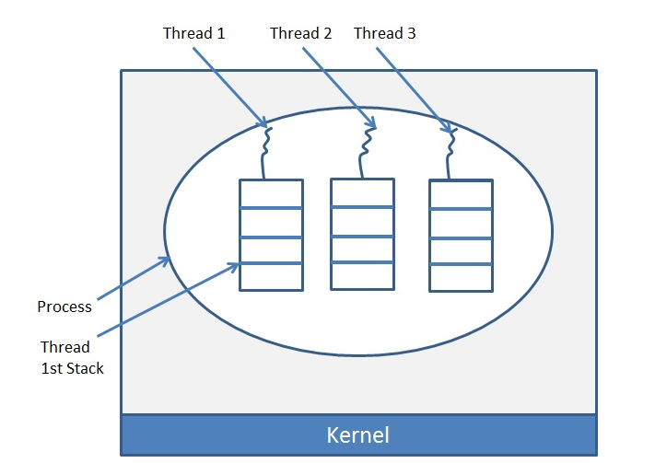
Word Processor:
A programmer wish to type the text in word processor. Then the programmer opens a file in a word processor and typing the text (It is a thread), the text is automatically formatting (It is another thread). The text automatically specifies the spelling mistakes (It is another thread), and the file is automatically saved in the disk (It is another thread).

Slide 5
Benefits
Responsiveness – may allow continued execution if part of process is blocked, especially important for user interfaces
Resource Sharing – threads share resources of process, easier than shared memory or message passing
Economy – cheaper than process creation, thread switching lower overhead than context switching
Scalability – process can take advantage of multiprocessor architectures

Slide 6
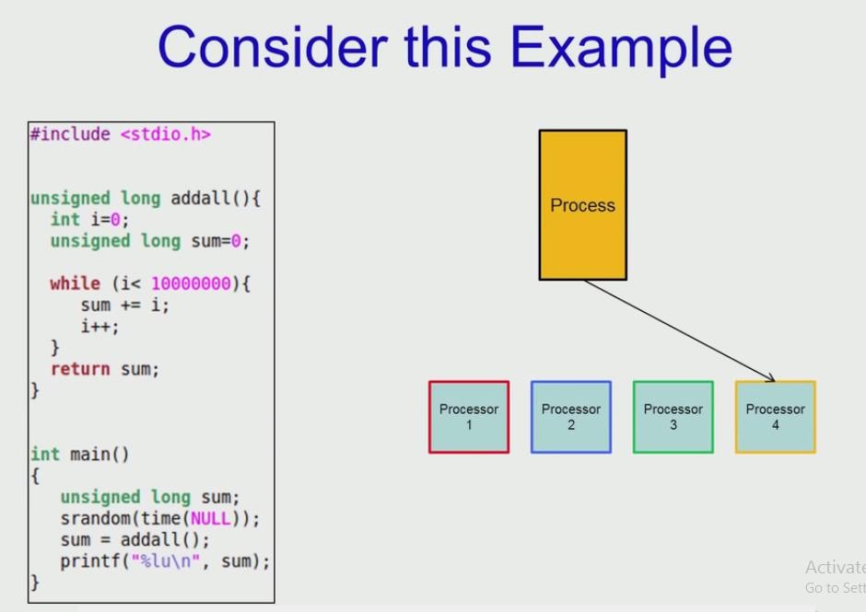

Slide 10
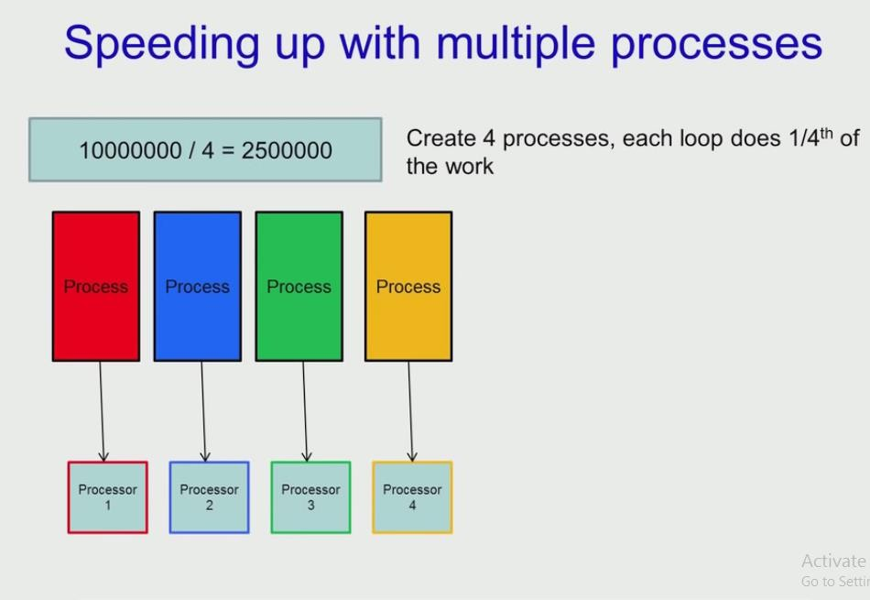

Slide 12
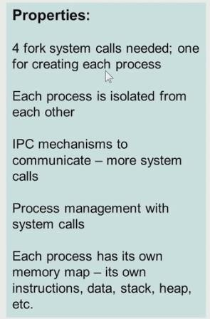

Slide 13



Slide 14
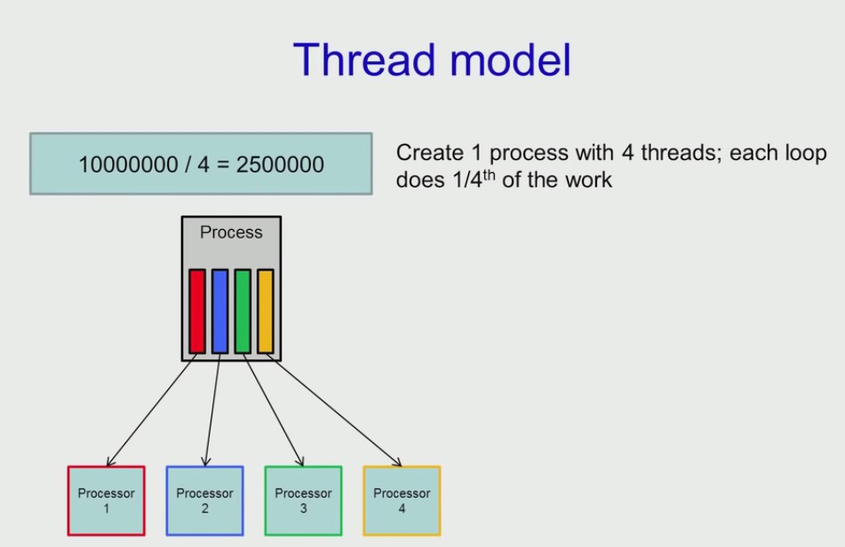

Slide 15
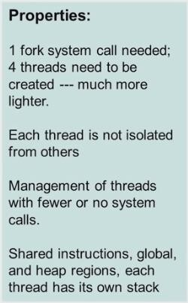

Slide 16








Single and Multithreaded Processes

Slide 17
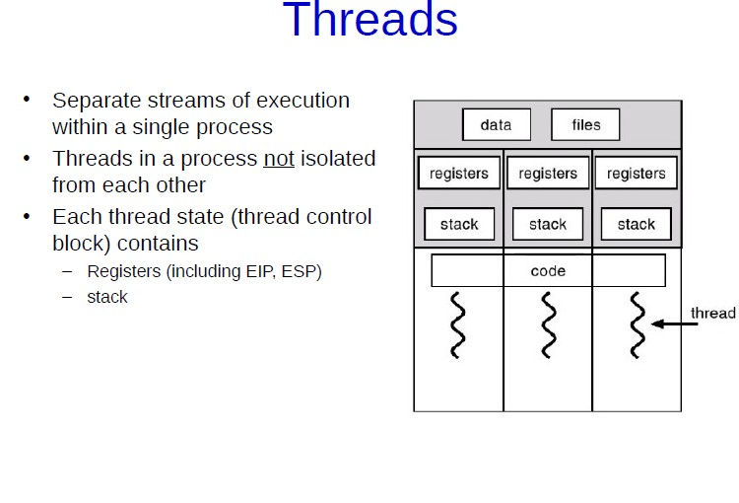

Slide 18
Why Threads?
Light Weight
Efficient Communication between the entities
Efficient Context Switching

Slide 19
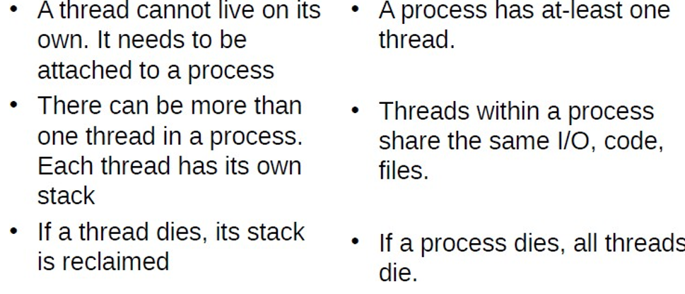
Thread vs Process

Slide 20
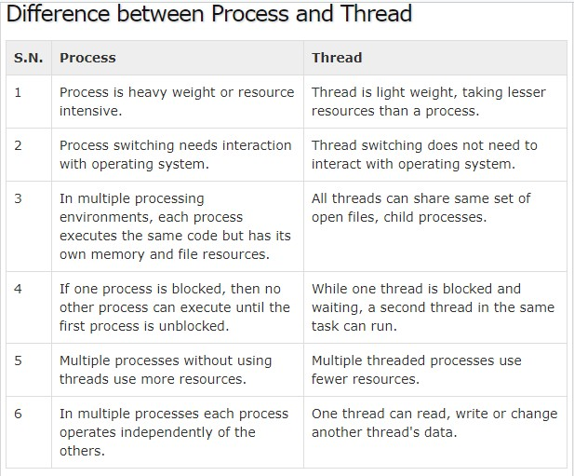

Slide 21
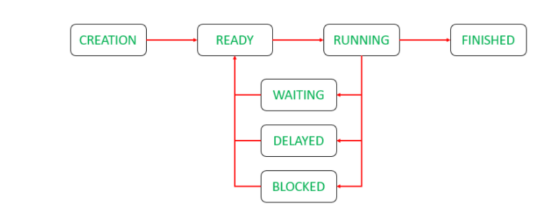
Thread States in Operating Systems

Slide 22
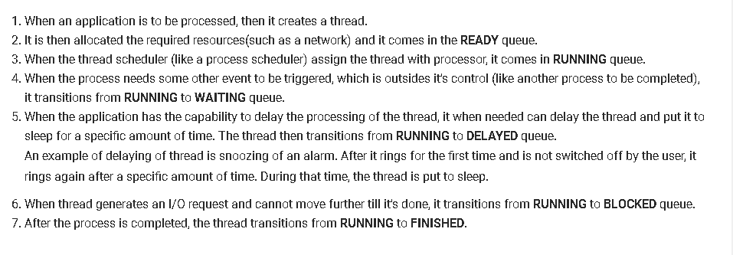

Slide 23
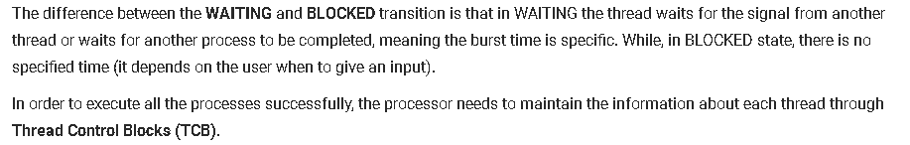

Slide 24
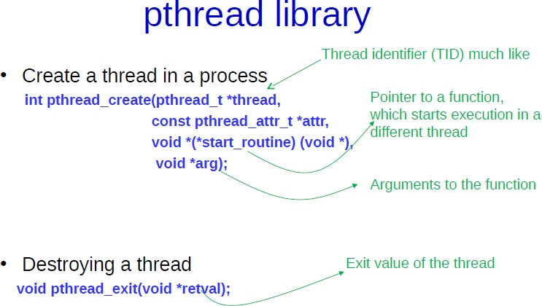

Slide 25
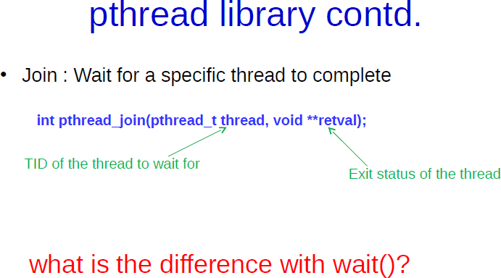

Slide 26
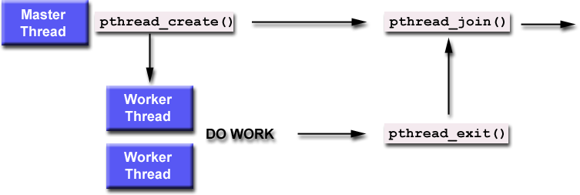
https://computing.llnl.gov/tutorials/pthreads/

Slide 27
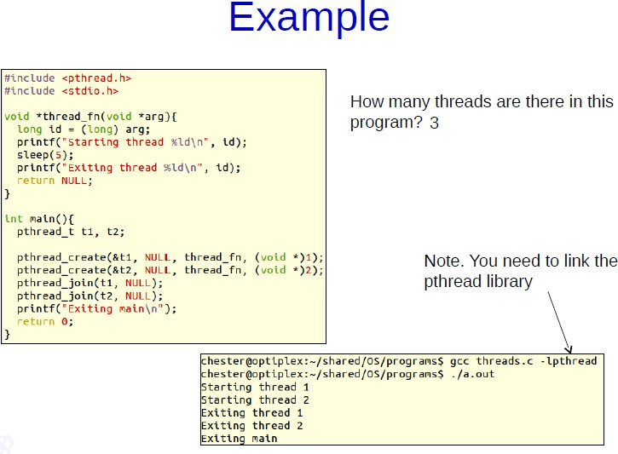

Slide 28
User Threads and Kernel Threads
User threads - management done by user-level threads library
Three primary thread libraries:
POSIX Pthreads
Windows threads
Java threads
Kernel threads - Supported by the Kernel
Examples – virtually all general purpose operating systems, including:
Windows
Solaris
Linux
Tru64 UNIX
Mac OS X

Slide 29
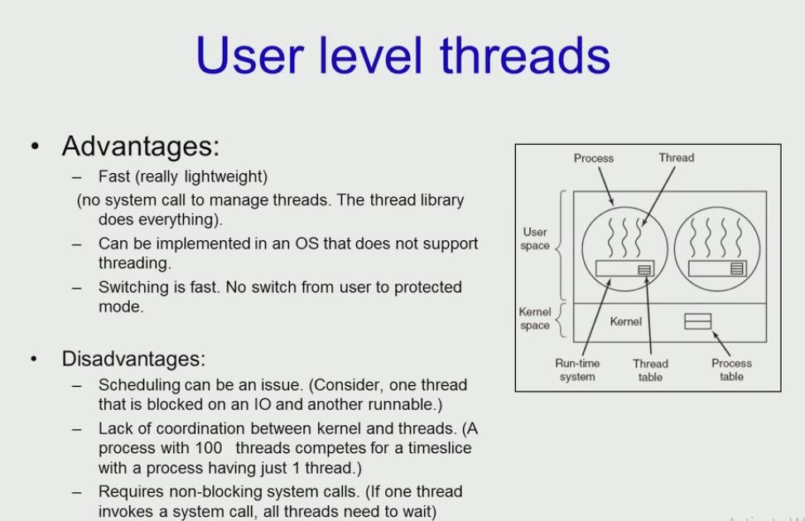

Slide 30
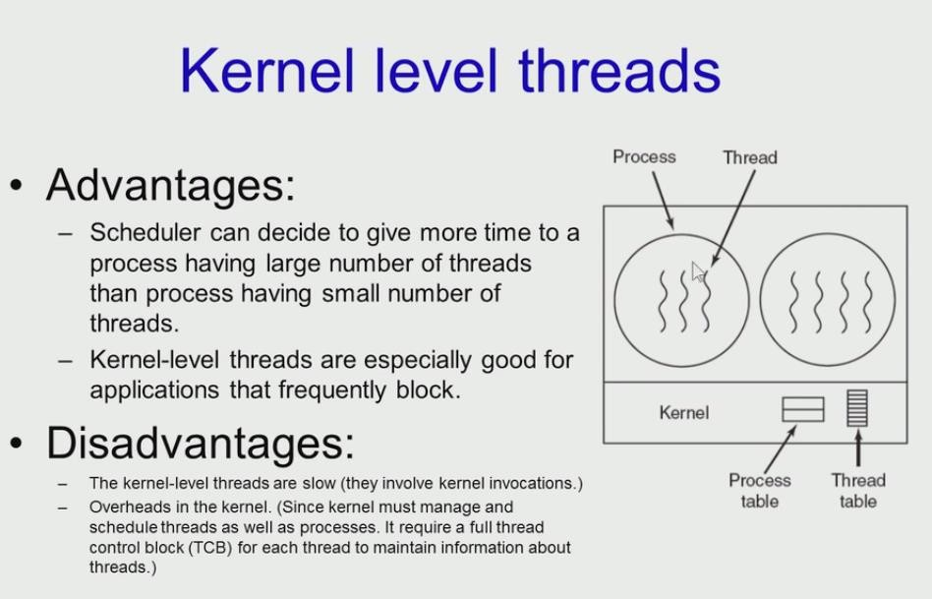

Slide 31
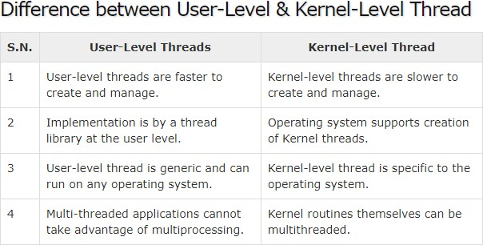

Slide 32
Multithreading Models
Many-to-One
One-to-One
Many-to-Many

Slide 33
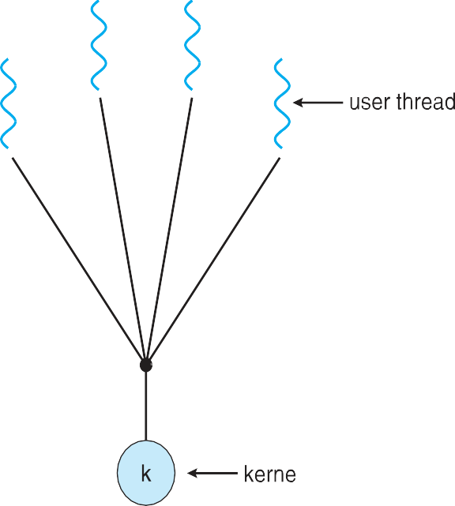
Many-to-One
Many user-level threads mapped to single kernel thread
One thread blocking causes all to block
Multiple threads may not run in parallel on muticore system because only one may be in kernel at a time
Few systems currently use this model
Examples:
Solaris Green Threads
GNU Portable Threads

Slide 34
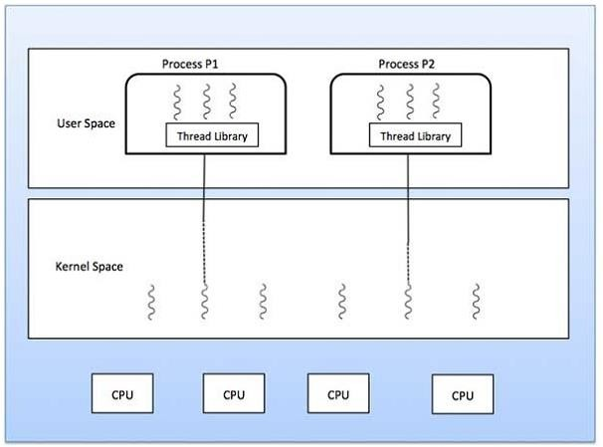

Slide 35
One-to-One
Each user-level thread maps to kernel thread
Creating a user-level thread creates a kernel thread
More concurrency than many-to-one
Number of threads per process sometimes restricted due to overhead
Examples
Windows
Linux
Solaris 9 and later

Slide 36
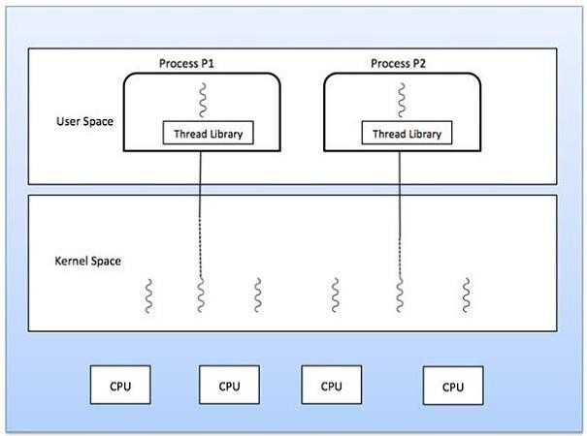

Slide 37


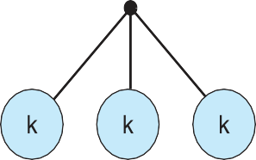
Many-to-Many Model
Allows many user level threads to be mapped to many kernel threads
Allows the operating system to create a sufficient number of kernel threads
Solaris prior to version 9
Windows with the ThreadFiber package

Slide 38

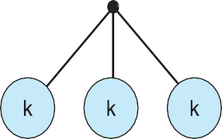
Two-level Model
Similar to M:M, except that it allows a user thread to be
bound to kernel thread
Examples
IRIX
HP-UX
Tru64 UNIX
Solaris 8 and earlier

